Slide 1

Python: Functions, Modules, and Data Manipulation

Slide 2

Introduction
Welcome to the world of Python, a versatile programming language known for its simplicity and power.
Today, we'll explore three key pillars of Python programming: Functions, Modules, and Data Manipulation.

Slide 3

The Building Blocks: Functions in Python
Functions are blocks of reusable code designed to perform a speciﬁc task. In Python, they play a crucial role in organizing and simplifying code.
Syntax:
`def function_name(parameters):` followed by the function's code block.
Key Concepts:
Parameters and Arguments
Return Statements
Scope and Lifetime of Variables

Slide 4

Modules are Python ﬁles containing Python deﬁnitions and statements. They help in organizing code and promoting code reusability.
Syntax: Importing a module using `import module_name`.
Notable Modules:
Math Module: for mathematical operations.
Random Module: for generating random numbers.
Datetime Module: for handling dates and times.
Streamlining Code with Modules

Slide 5
Putting it into Practice
Example 1 : Creating a function to calculate the factorial of a number.
Example 2 : Using the Math module to calculate square roots.
def factorial(n):
if n == 0 or n == 1: return 1
else:
return n * factorial(n - 1)
import math
def calculate_square_root(number): if number < 0:
return "Cannot calculate the square root of a negative number."
else:
return math.sqrt(number)
number = 5
result = factorial(number) print(f"The factorial of {number} is:
{result}")
input_number = 25
result = calculate_square_root(input_number) print(f"The square root of {input_number} is: {result}")
Output : The factorial of 5 is: 120
Output : The square root of 25 is: 5.0

Slide 6

Data manipulation is a key aspect of programming. Python provides powerful tools for working with data, making it a preferred language for data scientists and analysts.
Shaping Data with Python
Data Types in Python: Discussing the commonly used data types - int, ﬂoat, str, list, tuple, and dict.

Slide 7

Lists: Ordered, mutable sequences.
Tuples: Ordered, immutable sequences. Dictionaries: Unordered, mutable key-value pairs.
Operations on Data Structures:
Indexing and Slicing
Adding and Removing Elements
Iterating Through
Data Structures for Efﬁcient Manipulation

Slide 8
Beyond Basics - Leveraging Libraries
Demonstrating Data Manipulation with Pandas
import pandas as pd
# Creating a DataFrame
data = {'Name': ['Alice', 'Bob', 'Charlie', 'David'],
'Age': [25, 30, 22, 35],
'City': ['New York', 'San Francisco', 'Los Angeles', 'Chicago']}
df = pd.DataFrame(data)
# Displaying the Original DataFrame
print("Original DataFrame:")
print(df)
# Adding a new column
df['Salary'] = [60000, 80000, 55000, 70000]
# Filtering data based on a condition
young_people = df[df['Age'] < 30]
# Displaying the Modified DataFrame
print("\nDataFrame after Data Manipulation:")
print(df)
# Displaying the Filtered DataFrame
print("\nYoung People (Age < 30):")
print(young_people)
Introduction to Pandas:
A powerful library for data manipulation and analysis.
NumPy for Numerical Computing:
Discussing its role in array operations.
Matplotlib for Data Visualization:
A brief overview for plotting data.

Slide 9

Embracing Python's Magic
Python functions improve code structure and execution efﬁciency.
Modules enable code organization and reusability.
Python's data manipulation capabilities, including Pandas, NumPy, and Matplotlib, allow for efﬁcient data processing, analysis, and visualization

Slide 10
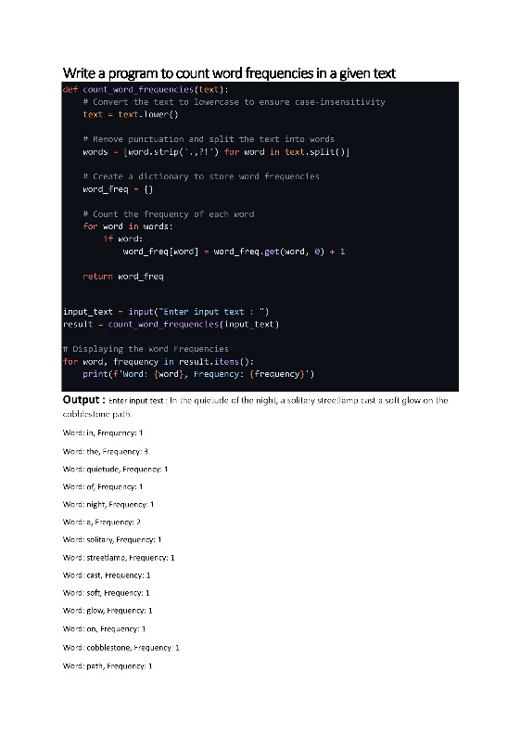

Slide 11
Thanks!
Presented by ~
Dharitri Raj

